Slide 1

Data Analysis & Programming for OM Q&A
Wout van Wezel
w.m.c.van.wezel@rug.nl

Slide 2

Contents
How get data from Elastic in a Dataframe?

Slide 3
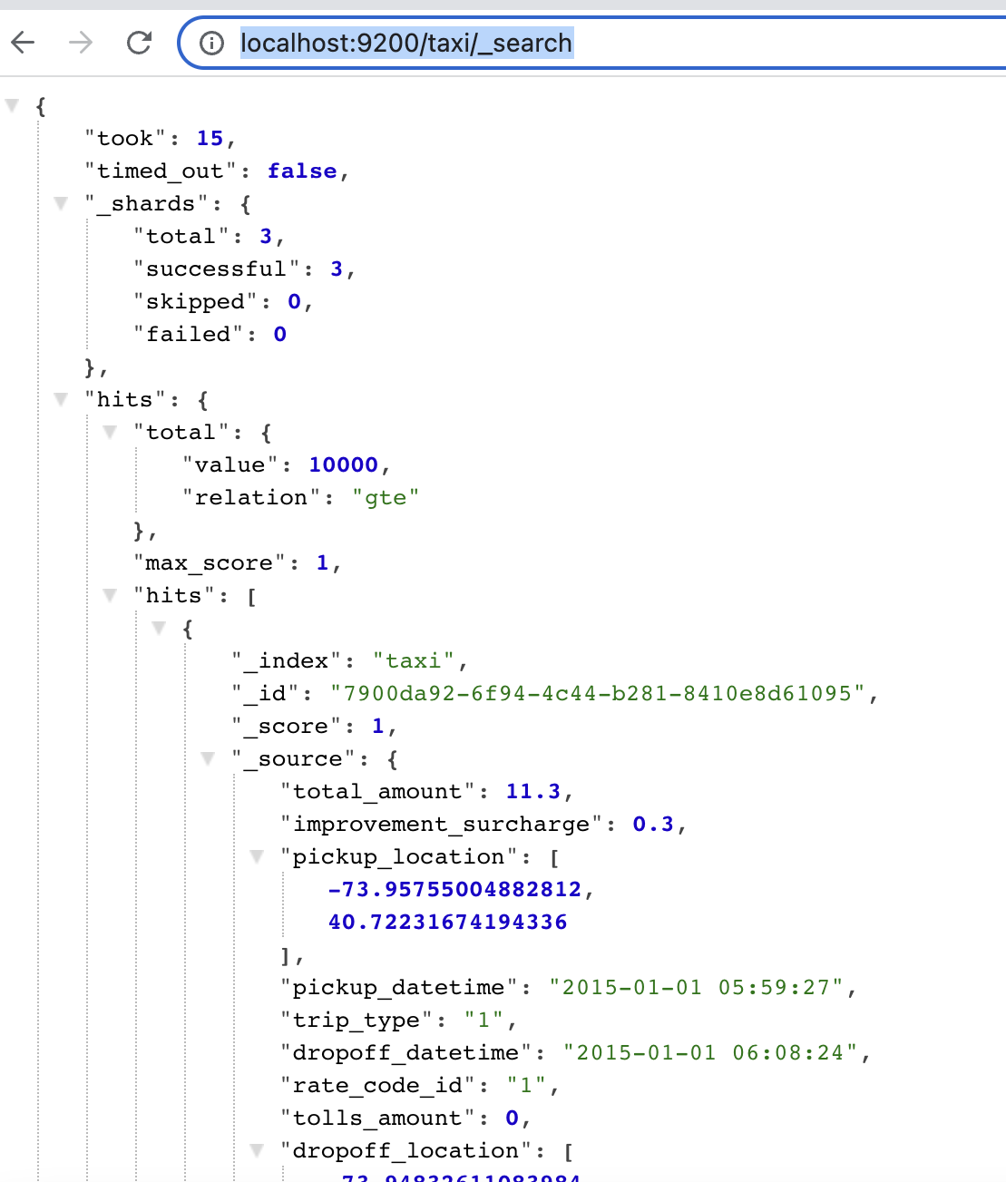
JSON
ES talks Json:
Your commands are formulated in Json
The result is sent back as Json
Json = Javascript Object Notation
Key/value pairs which can be nested
In Python, you communicate with ES through dictionaries
You formulate commands as a dictionary
You access the result as a dictionary

Slide 4
ES to Python
es = Elasticsearch(hosts="http://localhost:9200/") # get all products search_body = { "size": 0, "aggs": { "products": { "terms": { "field": "product_id", "size": 5 } } } } result = es.search(index="dapom_orders", body=search_body) print(type(result))
result could also be result.body in some versions of the library!

Slide 5
{
"took": 1,
"timed_out": false,
"_shards": {
"total": 1,
"successful": 1,
"skipped": 0,
"failed": 0
},
"hits": {
"total": {
"value": 10000,
"relation": "gte"
},
"max_score": null,
"hits": []
},
"aggregations": {
"products": {
"doc_count_error_upper_bound": 0,
"sum_other_doc_count": 2372991,
"buckets": [
{
"key": 655,
"doc_count": 5542
},
{
"key": 132,
"doc_count": 5523
},
Value
Key
Key is always a string
Value can be:
Number
String
Array
Dictionary

Slide 6
Iterate the dictionary
for key in result: print(key, type(result[key]))
took <class 'int'>
timed_out <class 'bool'>
_shards <class 'dict'>
hits <class 'dict'>
aggregations <class 'dict'>

Slide 7
Iterate the dictionary
for key in result["aggregations"]["products"]: print(key, type(result["aggregations"]["products"][key]))
doc_count_error_upper_bound <class 'int'>
sum_other_doc_count <class 'int'>
buckets <class 'list'>
So, result["aggregations"]["products"]["buckets"] is a list.

Slide 8
Iterate the dictionary
for bucket in result["aggregations"]["products"]["buckets"]:
print(bucket, type(bucket))
{'key': 655, 'doc_count': 5542} <class 'dict'>
{'key': 132, 'doc_count': 5523} <class 'dict'>
{'key': 929, 'doc_count': 5476} <class 'dict'>
{'key': 193, 'doc_count': 5410} <class 'dict'>
{'key': 582, 'doc_count': 5331} <class 'dict'>
So each element of the list 'buckets' is a dictionary.
→ I had 5542 orders for product 655, 5523 for product 132, etc.

Slide 9
Iterate the dictionary
for bucket in result["aggregations"]["products"]["buckets"]:
print("product: ",bucket["key"],"number of orders:", bucket["doc_count"])
product: 655 number of orders: 5542
product: 132 number of orders: 5523
product: 929 number of orders: 5476
product: 193 number of orders: 5410
product: 582 number of orders: 5331

Slide 10
Create a list
listWithProducts = [0] * 1500 #--> don't do this in your own code!
for bucket in result["aggregations"]["products"]["buckets"]:
listWithProducts[bucket["key"]] = bucket["doc_count"]
print(listWithProducts)

Slide 11
Create a Dataframe
A dataframe makes it much easier to do calculations, manipulations, filtering, etc.
dfWithProducts = pd.DataFrame(columns=['product_id', 'orders']) i=0 for bucket in result["aggregations"]["products"]["buckets"]: dfWithProducts.loc[i]=[bucket["key"], bucket["doc_count"]] i=i+1 print(dfWithProducts.head())
product_id orders
0 1 3053
1 2 2217
2 3 2208
3 4 735
4 5 4237

Slide 12
Create a Dataframe
A dataframe makes it much easier to do calculations, manipulations, filtering, etc.
dfWithProducts = json_normalize(result['aggregations']['products']['buckets']) print(dfWithProducts.head())
product_id orders
0 655 5542
1 132 5523
2 929 5476
3 193 5410
4 582 5331

Slide 13
Average per day
In the assignment you must:
Get a list with products
Per product:
Get the daily average
If you ask Elasticsearch for an aggregate, values that do not occur are not included in the result set!
Beware, if you use the json_normalize trick, and then ask the mean of the Dataframe, days on which there was 0 demand for a product, are not included!
Tip: either
Initialize an array with 0's and iterate the result set yourself, or
Use an Histogram aggregation with interval 1

Slide 14
Questions?

